Slide 1
“The Causal Effects of Place on Health and Longevity” (Deryugina et. al 2023)
By Alex bodeker

Slide 2
Question
Life expectancy outcomes vary substantially across different countries, and they even vary by county
How does one’s “place of residence” causally influence one’s life expectancy and general health?

Slide 3
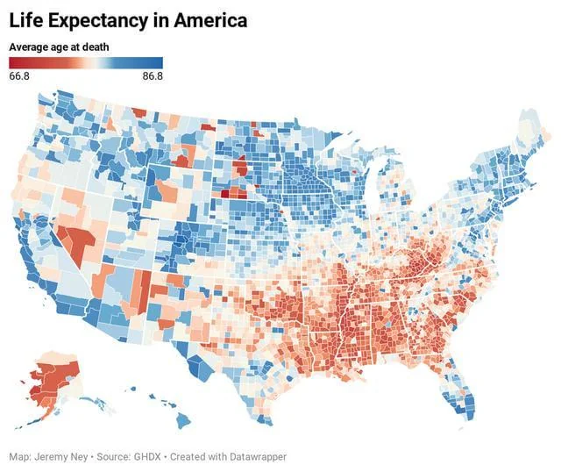
What we know
Regional differences within a country are due to both the physical environments and the population sorting
In U.S counties, life expectancy varies from ~69.1(Northern Louisiana) to ~89.5 (Cheyenne, Colorado)
Top 10% and bottom 10% earners have a county-level life expectancy of ~6.5 years
Variation occurs between states and counties suggesting strong local-level difference in longevity

Slide 4
How causal effects are studied between counties
Because normal cross-sectional studies can be ineffective in this situation due to it’s ”snapshot” nature, this study is more effectively conducted by analyzing ”movers” and how their move effects their life expectancy. This method accounts for:
Exposure changes between areas (healthcare, environment)
When people move based on social/economic reasons
Health changes over time
Understanding why people move from certain areas
This study uses data from Medicare, death certificates, socioeconomic data, and county level life expectancy data

Slide 5
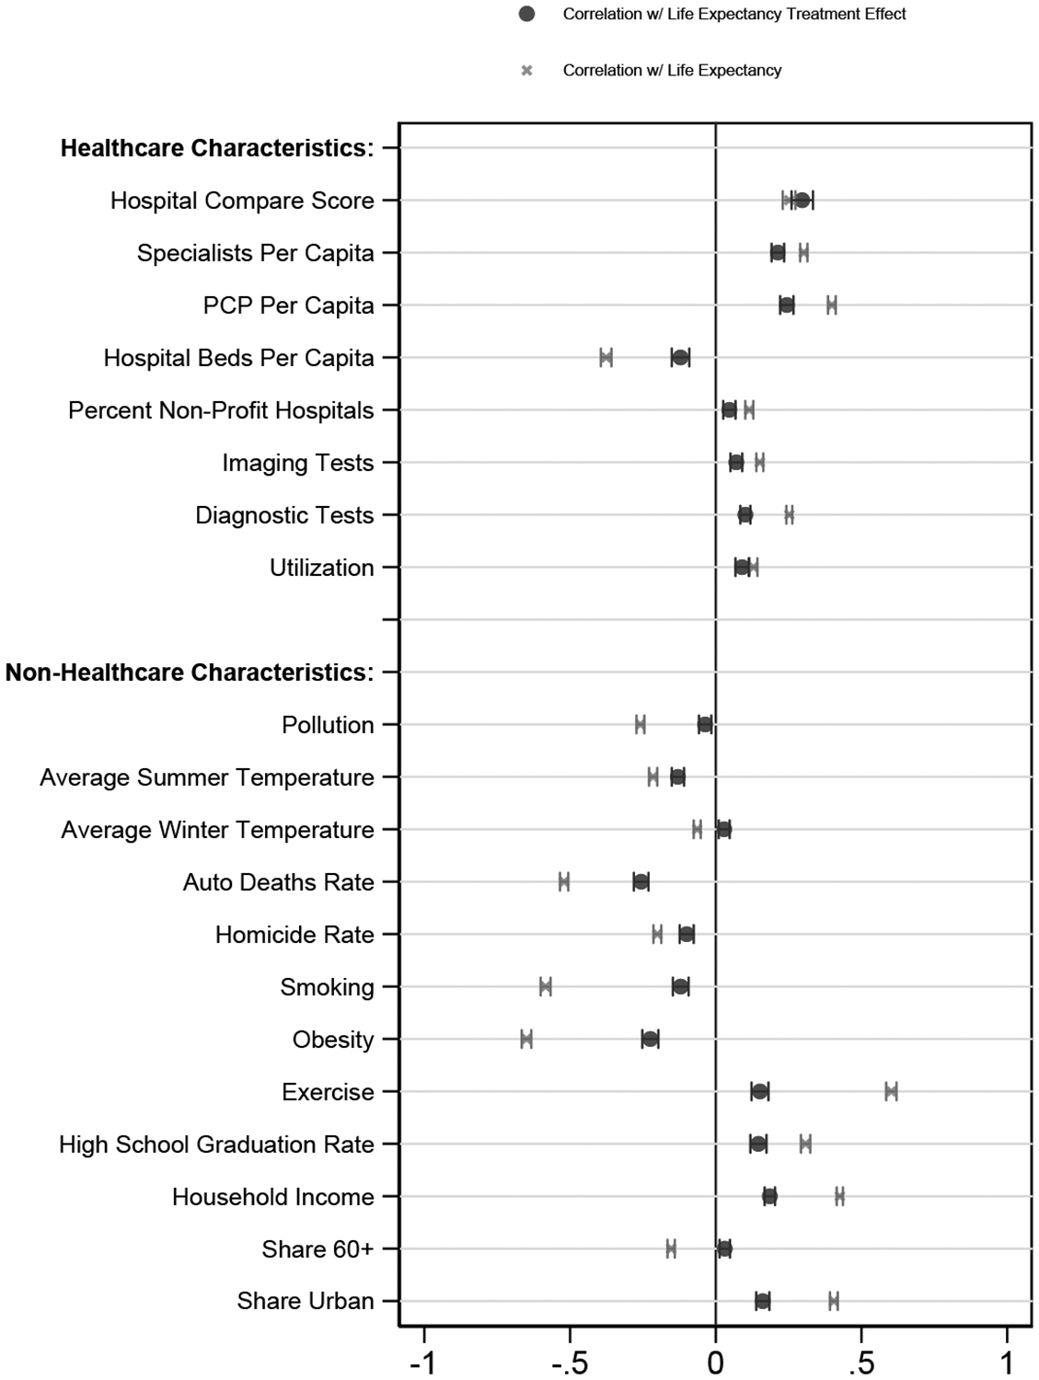
Causal effects of living in certain areas
Causal effects mean more than a correlation, as these effects lead to certain outcomes no matter the person. The main variables to consider as causal effects are :
Access to healthcare
Access to healthy food and water
Presence of safe recreational spaces
Prevalence of smoking/drug use
Pollution/hygiene
Finkelstein et al., 2021)

Slide 6
Evidence for causal effects of geographic location
Counties with higher median income, home value, and lower poverty are associated with higher life expectancy
Places with higher smoking/obesity rates have shorter life expectancy (influenced by social norms)
Pollution levels (fine matter) show strong negative correlation with life expectancy
Movers who relocated to low-mortality areas experienced lower mortality rates compared to those who stay
Places with more regulative policies are associated with improved expectancy. Tax rates on cigarettes also are associated with higher state-level life expectancy (Montez et al. 2020)

Slide 7
How big are these geographic effects?
If one were to move to an area where life expectancy is 1 year higher, the mover will live 0.23> longer on average (Finkelstein et al., 2021)
Movers to urban areas show increases drug/alcohol consumption
Older adults moving from low to high life expectancy areas receive an estimated +1.1 years in predicted lifespan
There is a 6.5 year interdecile gap

Slide 8
Graphical representation of life expectancy of an area vs the national average
How predicted life expectancy changes if moved to a healthier area
X: Average area life expectancy
Y: Predicted lifespan for person in area
Shows the effect of place on lifespan holding all else constant
The slope of this graph is roughly ~1.07-1.10, meaning for every +1 area life expectancy, one’s predicted lifespan improves by about 1.07 years
Expected Individual Life Expectancy
(years)
90 |
| ●
| ● ●
| ●
85| ●
| ●
| ●
| ●
80 | ●
| ●
| ●
| ●
75 |●_______________________________________________________
76 78 80 82 84 86 88 90
Area Life Expectancy (years)

Slide 9
Differences by age
The authors of the article emphasize these effects of location are much more prevalent in older adults, with things like air quality and access to healthcare. These attributes have more instant effect on one’s expectancy
Characteristics like education quality, social networks, and early environment would have long-term effect through lifespan. These aspects imply that the effects of place may be larger than just the direct causalities

Slide 10
How Urban Sprawl influences life expectancy
When an area solely relies on car travel to get around, the higher VMT per household leads to to higher traffic related deaths
Urban areas tend to have lower average BMI
The most compact vs most sprawled counties on average see a difference of ~2.7 years
More walkable areas, higher food quality, and work/social opportunities of urban areas are favored more by younger adults

Slide 11
Implications
In designing effective policies to make the collective life expectancy increase, local features matter most, as different counties vary in their negative and positive externalities.
The costs associated with moving to certain places must be considered at an individual level, as different environments pose different concerns whether it is health, peer pressure, etc.

Slide 12
Uncertainties/limitations
Even with the “movers” design, there is still possibilities of sorting/selection bias that may skew data
Most samples come from elderly or disabled individuals due to the data sources of Medicare and death certificates
This study applies most to older adults as they are more inclined to move, the implications on younger adults is less clear
Even if one’s longevity improves, it doesn’t tell us exactly about quality of life and the costs of moving
It is unclear exactly which causal effects are more pronounced or not

Slide 13
Sources
Deryugina, T., & Molitor, D. (2021). The causal effects of place on health and longevity. The journal of economic perspectives : a journal of the American Economic Association. https://pmc.ncbi.nlm.nih.gov/articles/PMC10512696/ ]
Finkelstein, A., Gentzkow, M., & Williams, H. (2021, August). Place-based drivers of mortality: Evidence from migration. The American economic review. https://pmc.ncbi.nlm.nih.gov/articles/PMC8653912/
Holford, T. (2025, April 29). Study reveals Stark differences in life expectancy across U.S. states over the past century. Yale School of Public Health. https://ysph.yale.edu/news-article/study-reveals-stark-differences-in-life-expectancy-across-us-states-over-the-past-century/
4. Mitchell, H. (2018, September). The Link Between Urban Sprawl and Life Expectancy. Journal Reports: Healthcare. https://www.wsj.com/articles/the-link-between-urban-sprawl-and-life-expectancy-1537149600?gaa_at=eafs&gaa_n=AWEtsqediT62r0JQU3dREk4aWY1fZep-ax8ebOhZU54CtnKItr1H86jgu3JI2OhW7T8%3D&gaa_ts=692fb8cc&gaa_sig=fFJWnI5VtKUNGzxyCRw03XuRZlQDr0JrAHL79y4YADrCR42yzzv_0qpJk12ITuJ36v_GOQrv3R0tKMVgw-dTbg%3D%3D

